Slide 1
Differential Pulse Code Modulation

Slide 2
DPCM
To improve the encoding efficiency of Analog to Digital conversion.
Disadvantage of PCM:
PCM efficiency is less
because it generates many bits and requires so much of bandwidth to transmit.

Slide 3
Why we go for DPCM
DPCM is used to reduce quantization error without increasing number of bits.
Advantages of PCM:
Decreases the bandwidth
Increases the SQNR

Slide 4
Motivation for DPCM
The standard sampling rate for pulse code modulation (PCM) of telephone grade speech signal
is fs = 8 Kilo samples per sec with a sampling interval of 125 μ sec.
Samples of this band limited speech signal are usually correlated
as amplitude of speech signal does not change much within 125 μ sec.

Slide 5
Motivation for DPCM
One desired feature of speech signal is used.
A typical auto correlation function R (τ ) for speech samples at the rate 8 Kilo samples per sec is shown in figure.
R (τ = 125 μ sec) is usually between 0.79 and 0.87.
This aspect of speech signal is exploited in differential pulse code modulation (DPCM) technique.

Slide 6
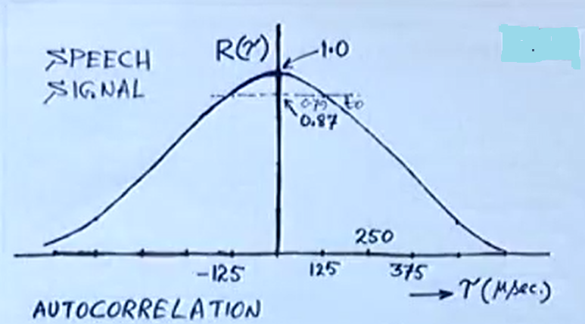

Slide 7


Motivation for DPCM
is time interval of correlation which is independent variable along ‘x’ axis.
= 125μs,250μs,375μs.
Mathematically on discrete time signals is given by

Slide 8
Motivation for DPCM
In PCM input signal is sampled at appropriate Nyquist rate or slightly higher than that.
i.e. 8 kilo samples per sec for PCM.
These samples for speech signals do not change from sample to sample .
Therefore two consecutive samples from sample and hold circuit exhibits high correlation.

Slide 9
Cont..
Therefore difference between 2 consecutive samples has a variance that is smaller than variance of the signal itself.
If these highly correlated samples are encoded using PCM, then resulting signal has redundant information.
By removing this redundancy before encoding, we obtain a more efficient coded signal.

Slide 10
Cont..
If sufficient part of the redundant signal is known,
Then linear prediction is used to infer the rest or at least make most probable estimate.
It is possible to predict future values of input signal x(t) provides motivation for DPCM.

Slide 11
Cont..
If particular about one sample and if missed that sample
By taking the next sample , we can predict what that previous samples was.
Or
If observing a sample at a particular instant of time,
we can estimate what is going to be the amplitude of next sample which has not yet come.
We make use of this feature in design of DPCM.

Slide 12
DPCM
In analog message, a good guess about a sample value from a knowledge of the past sample values can be made.
In other words, the sample values are dependent and have great redundancy in the Nyquist samples.
Proper exploitation of this redundancy (i.e. by removing this redundancy)

Slide 13
Simple Scheme
Leads to encoding signal with a lesser number of bits.
Consider a simple scheme where instead of transmitting the samples values,
Transmit the difference between successive sample values.
Thus, if x(kTs) is the k th sample, instead of transmitting x(kTs), we transmit the difference
ep(kTs)= x(kTs)-x[(k-1)Ts].

Slide 14
Receiver
At the receiver, knowing ep(kTs) and the previous sample value x[(k-1)Ts], we can reconstruct x(kTs).
Thus, from the knowledge of the difference ep(kTs), we can reconstruct x(kTs) iteratively at the receiver.

Slide 15
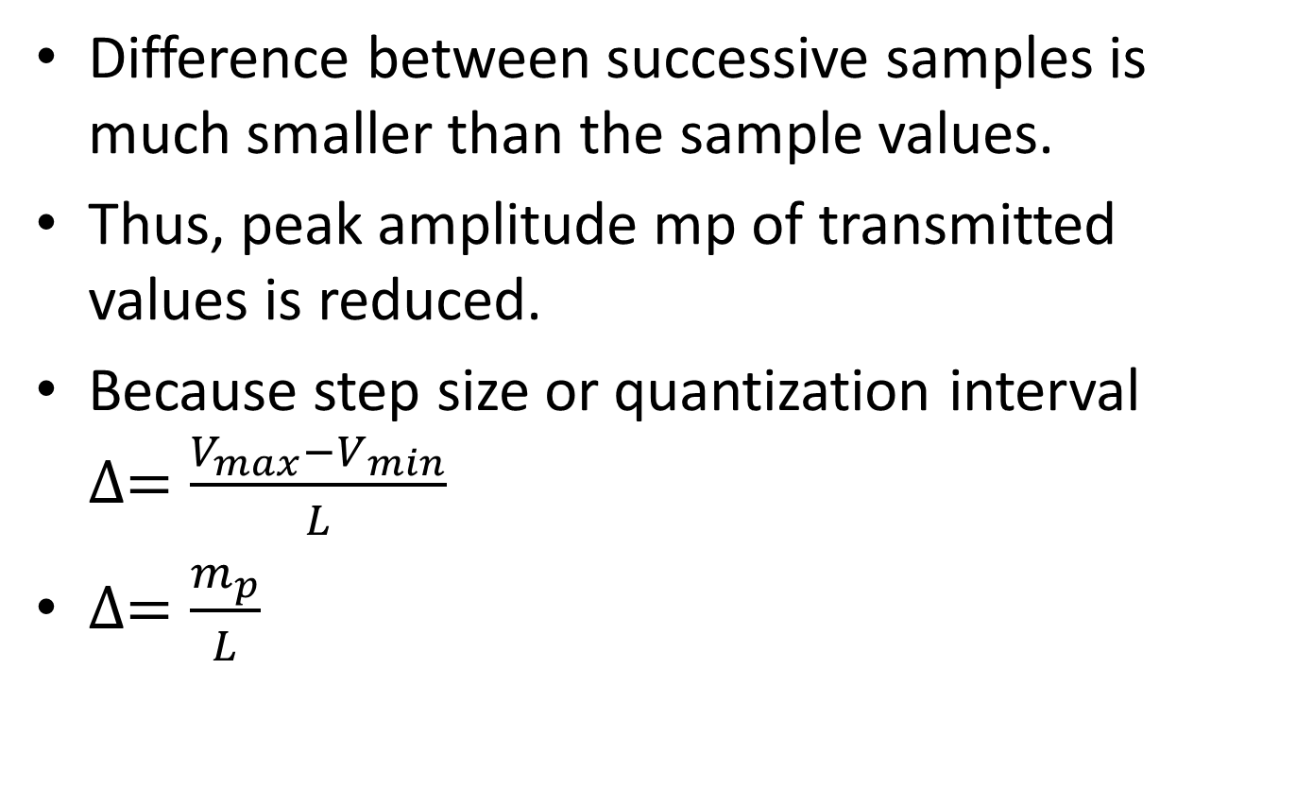
Cont..
Difference between successive samples is much smaller than the sample values.
Thus, peak amplitude mp of transmitted values is reduced.
Because step size or quantization interval $∆=\frac{V_{max}−V_{min}}{L}$
$∆=\frac{m_{p}}{L}$

Slide 16
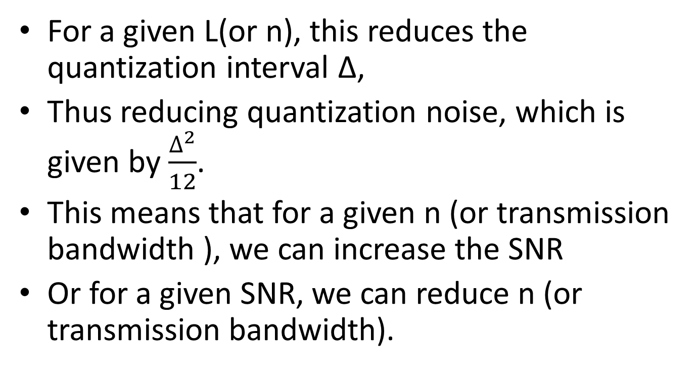
Cont..
For a given L(or n), this reduces the quantization interval Δ,
Thus reducing quantization noise, which is given by $\frac{∆^{2}}{12}$.
This means that for a given n (or transmission bandwidth ), we can increase the SNR
Or for a given SNR, we can reduce n (or transmission bandwidth).

Slide 17
DPCM
We can improve this scheme by estimating (predicting) the value of the k th sample x(kTs) from a knowledge of the previous sample values.
If this estimate is x^(kTs), then transmit the difference (prediction error)
ep(kTs)= x(kTs)-x^(kTs).
At receiver also, determine the estimate x^(kTs) from the previous sample values

Slide 18
Cont..
And then generate x(kTs) by adding the received ep(kTs) to estimate x^(kTs).
Thus reconstruct the samples at the receiver iteratively.
If the prediction is good, the predicted (estimated) value x^(kTs) will be close to x(kTs).
And the difference (prediction error) will be even smaller than the difference between successive samples.
This scheme is known as Differential PCM.

Slide 19
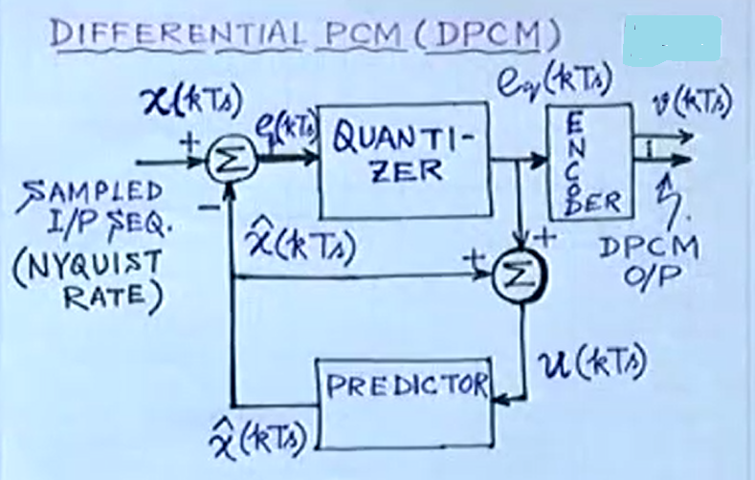
DPCM Block Diagram

Slide 20
DPCM Block Diagram
Input is sampled i/p speech signal at Nyquist rate or slightly higher than that
Typically for speech signal 8 kilo samples per sec.
i/p is denoted as x(kTs)- K th sample.
And getting another input from Predictor.
Predictor predicts what this x(kTs) would have been.

Slide 21
Cont..
By using the correlation feature of the speech signal prediction is done.
Assuming the prediction is good, if there is high correlation between adjacent samples.
Then this predicted value x^(kTs) is very close to x(kTs).
This prediction error ep(kTs) is given as input to quantizer.
This is the difference between PCM & DPCM.

Slide 22
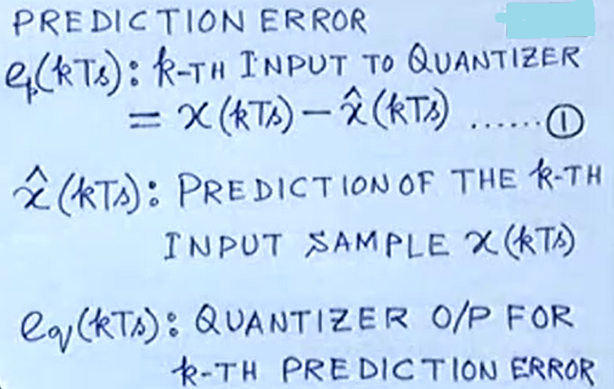
Cont..

Slide 23
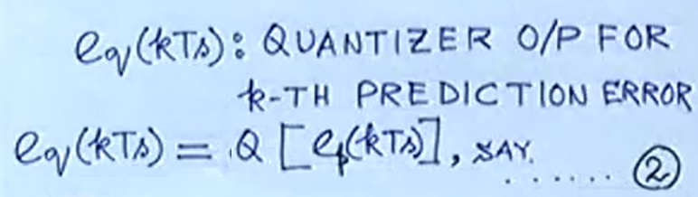


Quantizer Output
Q depends on the type of quantizer .

Slide 24
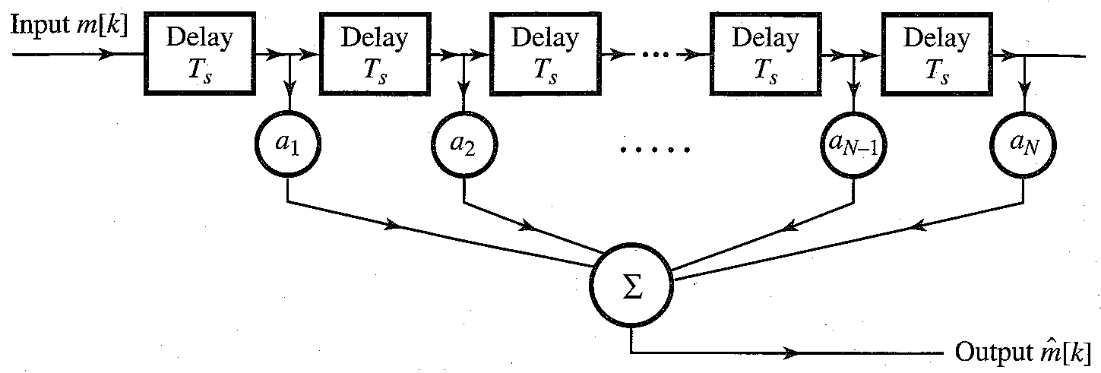
Predictor
x^(kTs) depends on all previous samples x((k-1)Ts),x((k-2)Ts), x((k-3)Ts)……

Slide 25
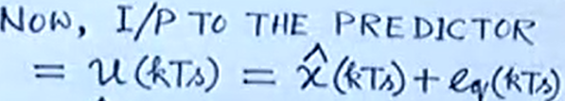

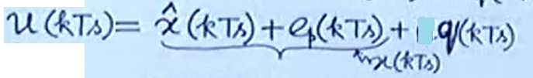
Predictor
This quantized output eq(kTs)is added with previous predicted value x^(kTs) to give next input to predictor.
Substitute for eq(kTs) from equation 3

Slide 26

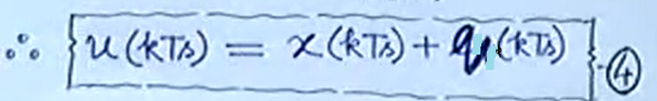
Cont..
From equation 1
Substitute this in u(kTs) then we get

Slide 27
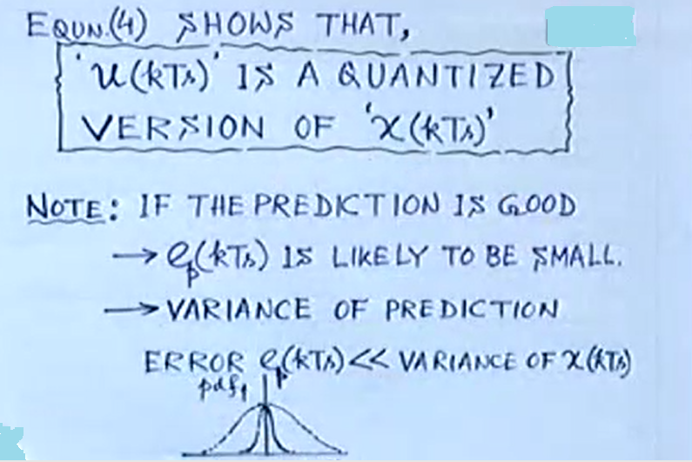
Cont..

Slide 28
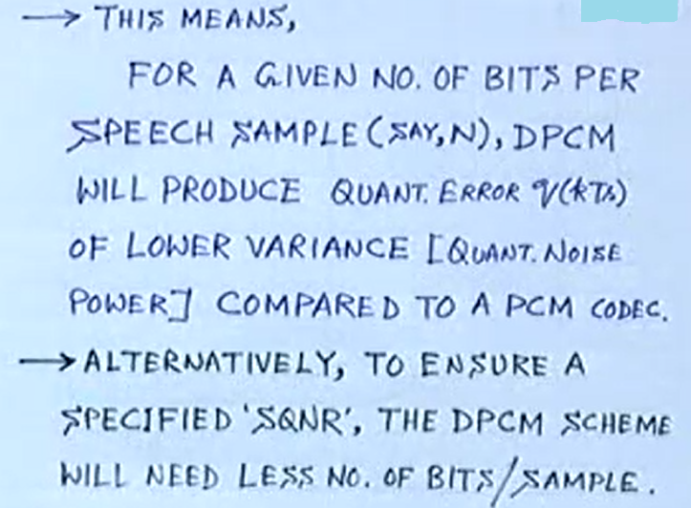
Advantage of DPCM

Slide 29
Advantage of DPCM
Increases SQNR after coding.
Reduces bit rate by following this differential approach compared to PCM.
For the same SNR, the bit rate for DPCM could be lower than that for PCM by 3-4 bits per same.
Thus, telephone systems using DPCM can operate at 32 kbits/s or even 24 kbits/s.

Slide 30
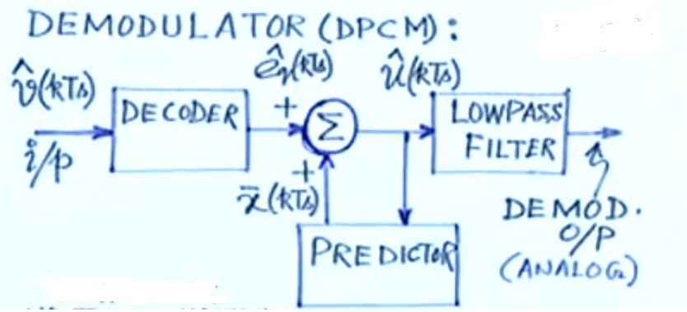
DPCM Receiver

Slide 31
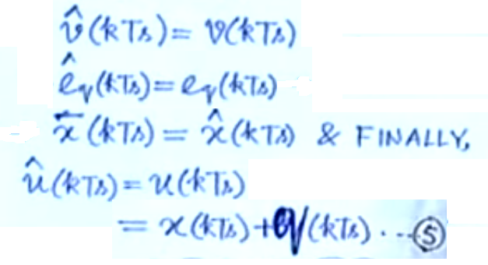
Cont…

Slide 32
Cont…
u(kTs) is closed version of x(kTs) by equation 5
This helps in visualizing corresponding receiver structure.
Decoder is needed to get back quantized output e^q(kTs).
Its reconstructed from decoder o/p using same predictor as used in Txr.

Slide 33
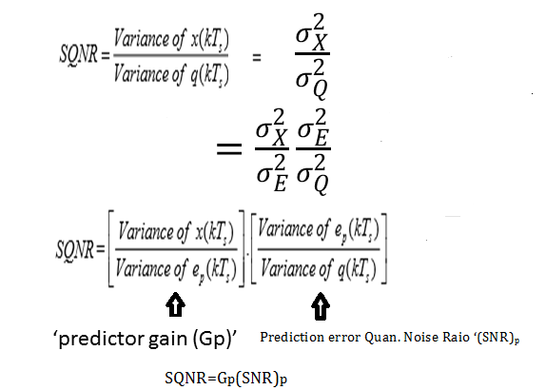
Calculation of SQNR for DPCM
The expression for signal to quantization noise power ratio for DPCM coding is:

Slide 34
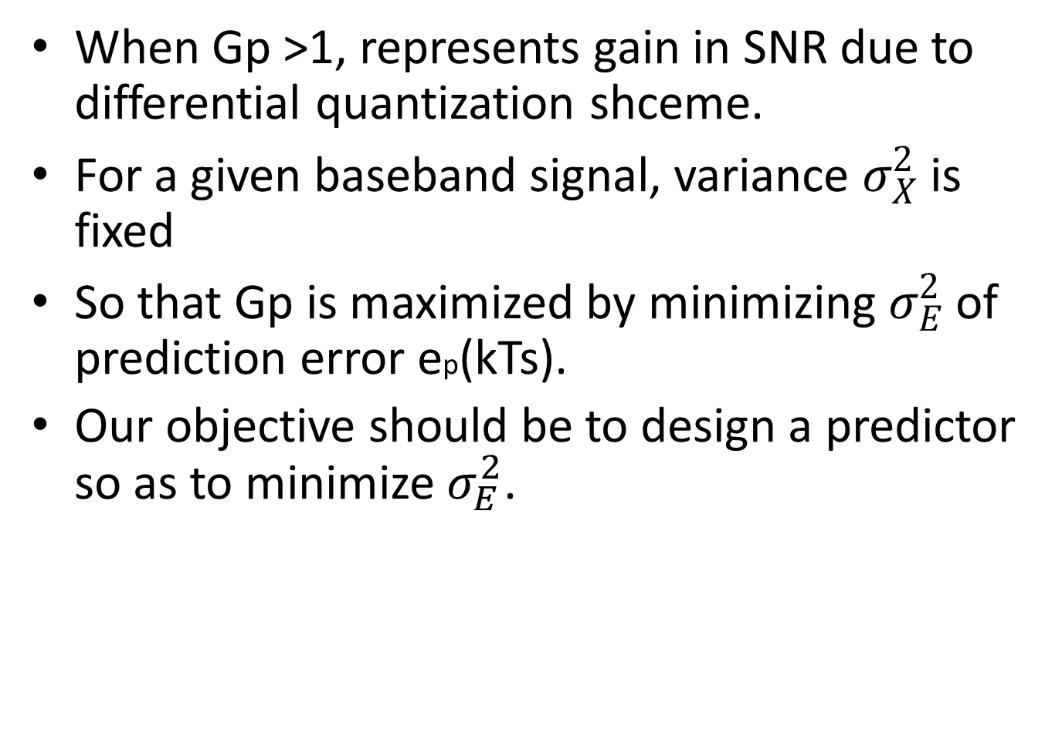
Cont…
When Gp >1, represents gain in SNR due to differential quantization shceme.
For a given baseband signal, variance $σ_{X}^{2}$ is fixed
So that Gp is maximized by minimizing $σ_{E}^{2}$ of prediction error ep(kTs).
Our objective should be to design a predictor so as to minimize $σ_{E}^{2}$.

